Slide 1

Days of Christmas
12
...but how many gifts?
?
364
78
12

Slide 2


“My true love gave to me...”

Slide 3


1
“A partridge in a pear tree”

Slide 4

2
“Two turtle doves”

Slide 5
3
“Three French hens”

Slide 6

4
“Four calling birds”

Slide 7
5
“FIIIIIVE GOOO-OLD(en) RIIINGS!!!”

Slide 8

6
“Six geese a-laying”

Slide 9

7
“Seven swans a-swimming”

Slide 10

8
“Eight maids a-milking”

Slide 11

9
“Nine ladies dancing”

Slide 12
10
“Ten lords a-leaping”

Slide 13

11
“Eleven pipers piping”

Slide 14

12
“Twelve drummers drumming”

Slide 15

364 Total Presents?
1 + (1+2) + (1+2+3) + (1+2+3+4) + etc...
(n x (n+1) x (n+2) ) / ½ n
(12 x 13 x 14 ) / 6
Notes:
Tetrahedral

Slide 16
78 Total Presents?
1 + 2 + 3 + 4 + 5 + 6 + 7
+ 8 + 9 + 10 + 11 + 12
½ n ( n+1 )

Slide 17
12 Total Presents?
+
+
+
+
+
+
+
+
+
+
+

Slide 18
Or just the one gift?

Slide 19


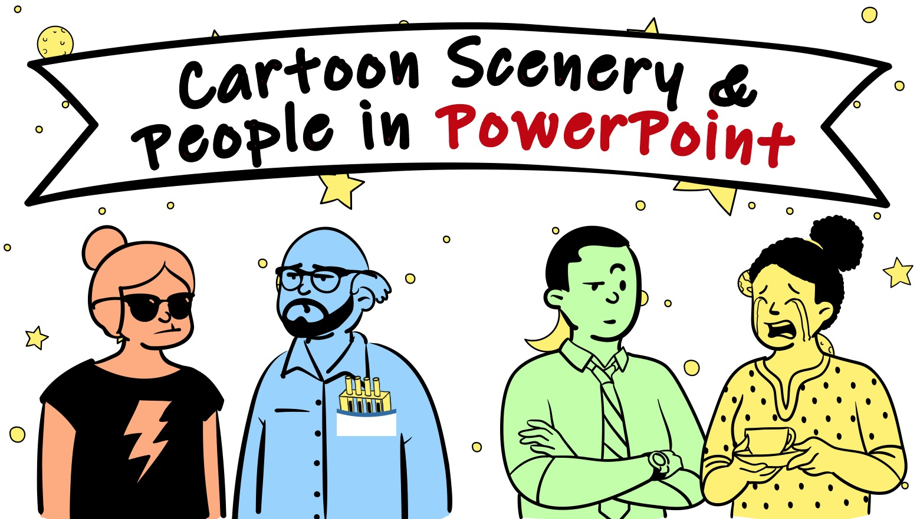




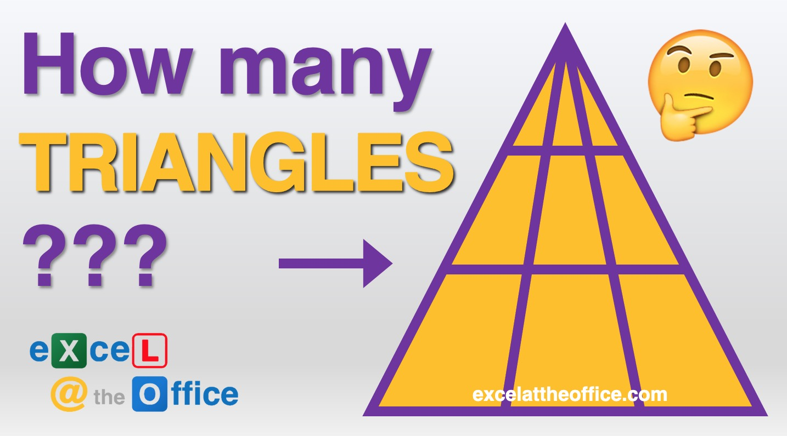
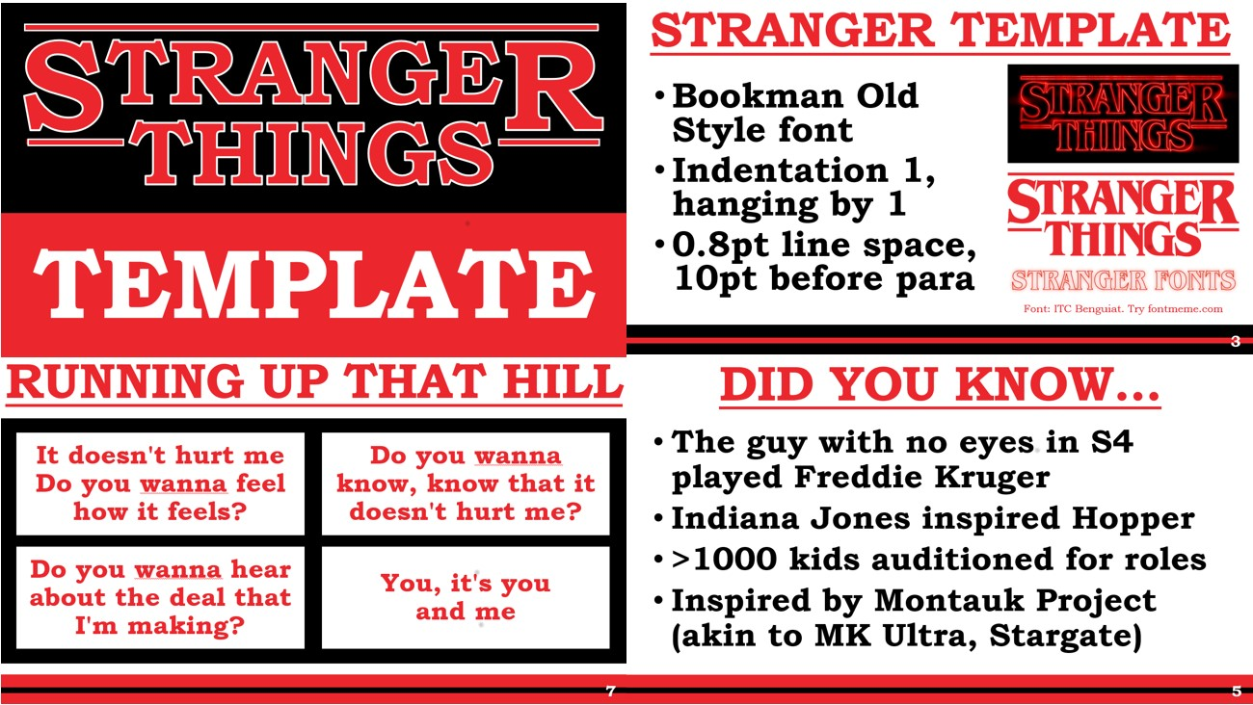

Slide 20



