Slide 1
5 Practices
for Perfect
P
resentations
Top tips to deliver
great presentations!

Slide 2
Keep Design Simple
Congruence throughout
Avoid MS Office templates?
Shapes & colours
Focus attention on content!
MS stock images helpful

Slide 3
5 Practices for
Perfect PowerPoints
Top tips to deliver great work!

Slide 4
Consider Accessibility
Biggest text possible
Black text on white background
Inclusive to everyone
Avoid confusing colour combos

Slide 5
Less is More!
Don’t overload slides
Use text sparingly
You’re not there to just read
Make use of speaker notes
Avoid distracting designs: Nobody cares

Slide 6
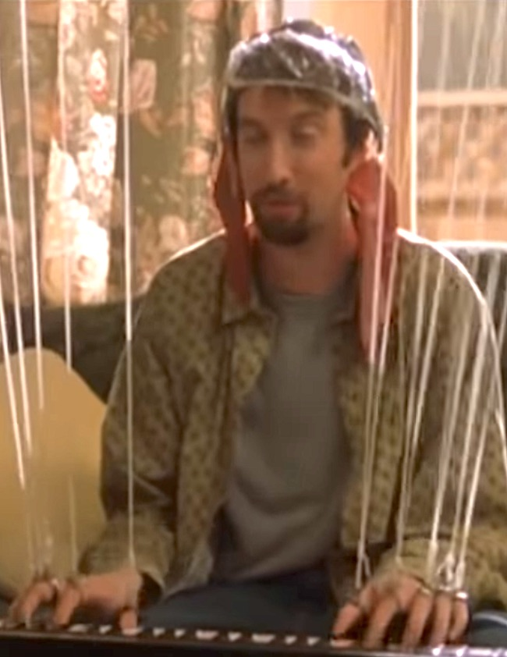
Avoid Over-Animation
Subtle & dynamic
Professionalism
‘Subtle’ & ‘basic’
Also transitions!
In doubt? Leave out!

Slide 7
Rehearse!
In head or out loud
Helps you remember content
Better engages audience
1 min presentation = 1 hour preparation

Slide 8
Summary...
Simple design
Accessibility
Less is more
Avoid over-animation
Rehearse

Slide 9
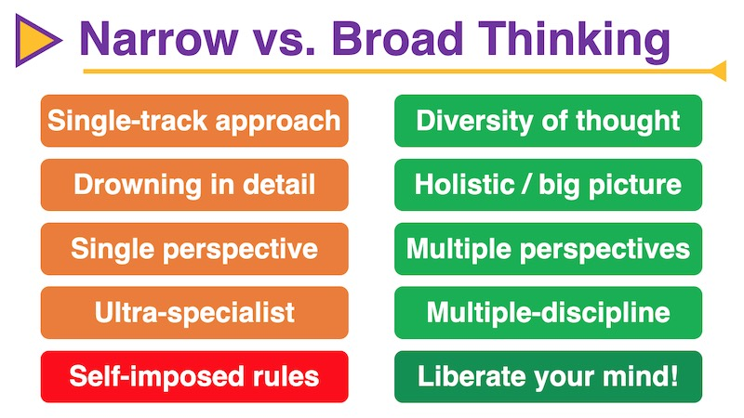
Examples from EATO...

Slide 10
